Slide 1

AL-FARABI KAZAKH NATIONAL UNIVERSITY
Department of Philology and World languages
English in Science
Januzakova Ayan Almukhanovna
MD in science, senior lecturer

Slide 2
Module 1
Reading Scientific Texts
Lecture 1
Pronunciation of biology terms

Slide 3
Overview
Biology terms
How to read biological terms
Prefixes and suffixes
Practice

Slide 4
Part 1
Biology Terms

Slide 5

Scientific English is a subset of academic English and English used by those studying scientific subject.
academic English
scientific terminology

Slide 6

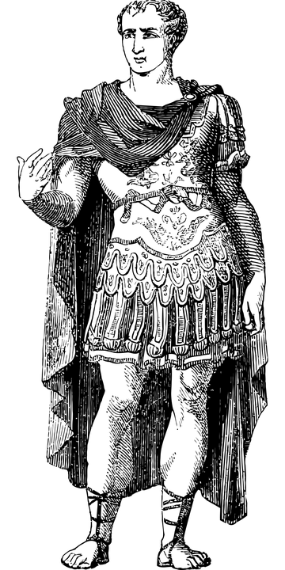
Greek
Biology Terms
Latin

Slide 7




Biology (root: bio)
Biology
Biologie
Biología
Биология
Biochemistry
Biotechnology
Biodiversity
Bioengineering
Bio fuel

Slide 8
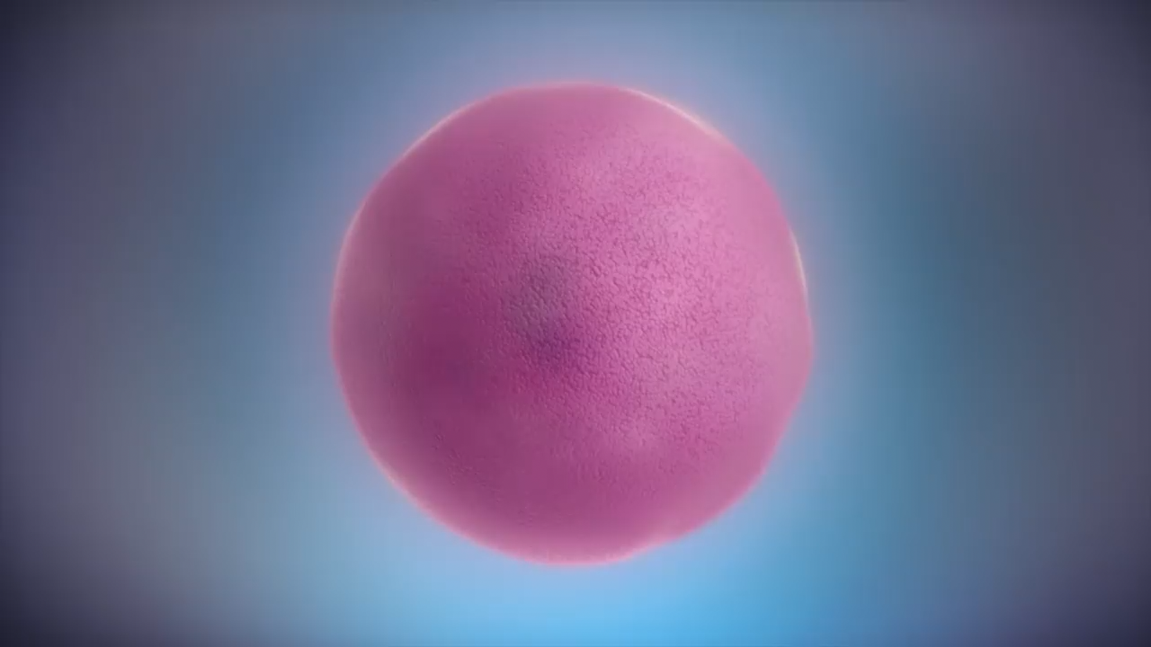
From DNA to Protein
https://www.youtube.com/watch?v=gG7uCskUOrAPROTEIN

Slide 9
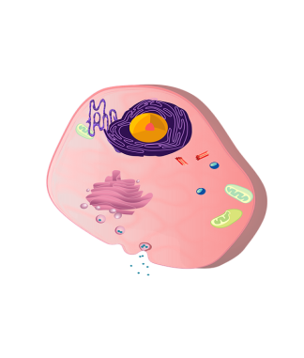
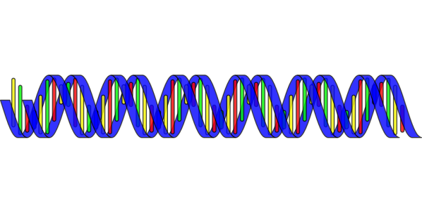
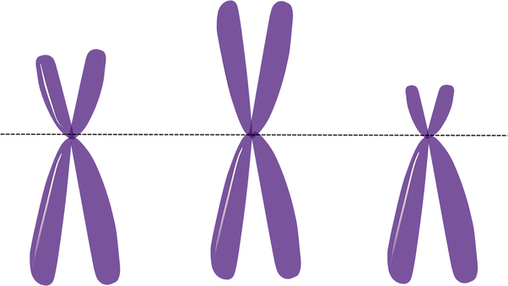
Genome | геном
Chromosome | хромосома
Histones | гистоны
DNA | ДНК
RNA | РНК
RNA polymerase | РНК полимераза
Cytoplasm | цитоплазма
Transcription | транскрипция

Slide 10
Part 2
How to read biological terms

Slide 11
Pt
Pterodactyl
Ptosis
Ptyalin
Pteropod
Pteridosperm
[t]

Slide 12
Pn
Pneumonia
Pneuma
Pneumocytosis
Pneumococcal Infection
[n]

Slide 13
Ps
Psychology
Pseudoscience
Psychobiology
Pseudopodium
Psittacosis
[S]

Slide 14
Ch
Chemistry
Technology
Mitochondria
Chondritis
[K]

Slide 15
ph
Physiology
Staphylococcus
Phospholipids
Cephalous
[F]

Slide 16
- i
Fungi
Bronchi
Nuclei
Bacilli
[ai]

Slide 17
Practice
Staphylococci
Lactobacilli
Biochemistry
Biotechnology
Enterococci
Pseudobiology

Slide 18
Part 2
Prefixes and suffixes

Slide 19
Prefixes
Hydro - | Hydrophilic
Micro - | Microorganism
Cyto - | Cytokinesis
Anti – | Antibody
Exo – | Exo
Bi - | Bilayer
Di- | Dichotomous

Slide 20
Suffixes
Cide | Pesticide
Ize | Synthesize
Cule | Molecule
Phyll | Chlorophyll
- itis | Laryngitis
Xyl | hydroxyl

Slide 21
Part 3
Practice

Slide 22
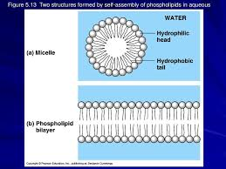
Phospholipids are major components of cell membranes
Phospholipids are similar to fats, but they have only two fatty acids rather than three. The third hydroxyl group of glycerol is joined to a phosphate group, which is negative in electrical charge. Additional small molecules, usually charged or polar, can be linked to the phosphate group to form a variety of phospholipids (Figure 1).

Slide 23
Phospholipids show ambivalent behavior toward water. Their tails, which consist of hydrocarbons, are hydrophobic and are excluded from water. However, the phosphate group and its attachments form a hydrophilic head that has an affinity for water.
When phospholipids are added to water, they self-assemble into aggregates that shield their hydrophobic portions from water. One such cluster is a micelle, a phospholipid droplet with the phosphate heads on the outside, in contact with water. The hydrocarbon tails are restricted to the water-free interior of the micelle.

Slide 24
At the surface of a cell, phospholipids are arranged in a bilayer, or double layer. The hydorphilic heads of the molecules are on the outside of the bilayer, in contact with the aqueous soultions inside and outside the cell. The hydrophobic tails point toward the interior of the membrane, away from the water. The phospholipid bilayer forms a boundary between the cell and its external environment; in fact, phospholipids are major components of cell membranes.

Slide 25
Practice.
Hydroxyl
Phospholipids
Glycerol
Hydrocarbon
Hydrophilic
Micelle
Bilayer
Cell membrane

Slide 26
Pneumonoultramicroscopicsilicovolcanoconiosis
Lung disease caused by inhalation of silica dust.

Slide 27
Summary
How to read and pronounce the scientific terms in English.

